Slide 1

Chapter 10
Prepare For An Attack

Slide 2

Attacks on the evidence
Seriousness of the situation
Criticize evidence as less than perfect
No such thing as a perfect case
Claim that we can’t possibly know the truth
What “Might have been”, “Could have been”
Can’t make decision till you know more
Notes:
-Seriousness:: In court, the defense usually takes advantage of the seriousness of the jury and makes unreasonable demands of the prosecution by criticizing that the evidence provided was something less than perfect.
-Criticize:: :we can’t know the truth because not every proverbial stone was left unturned.
-No:: Jurors must understand that there is no such thing as a “perfect” case. Jurors never witness a crime first-hand, so they never have perfect evidence.
-Claim:: Ask them ”can we know that truth?” Expect an attack on the nature of what truth is
-Can’t:: Skeptics sometimes ask why there aren’t more secular writings to corroborate more claims in the bible. (more on that in chapter 12)

Slide 3
”Extraordinary claims require extraordinary evidence”
A Tactic to suggest you cannot possibly know for sure
Ask “Does that claim require extraordinary evidence?”
That’s a self-refuting statement that says nothing
A word-game to distract from the evidence
Almost every belief we have requires some faith
Notes:
-Almost:: The chair you sit in requires faith. Starting your car required faith.
You had faith that the last thing you ate wouldn’t make you sick

Slide 4

Speculation to throw you off
“possible” vs. “reasonable”
Defense will focus on “possible”
Prosecution makes distinction between the two
Possible that Jesus of Nazareth is a myth copied off another writing?

Slide 5
Mithras – a ‘savior’ story
Claim: Jesus is not the only ‘savior’ story
Claim: Mithras story came out 400 years before the 1st Christians
-Mithras was born of a virgin -born in a cave, attended by shepherds -had 12 companions or disciples -was buried in a tomb and after 3 days rose again -was called “the Good Shepherd” -was identified with both the “Lamb and the Lion”.
Notes:
(next slide) what do we have to say about that?

Slide 6
Mithras – one problem
Unsupported by the evidence
No existing “Mithraic scripture” available
Only have Mithraic paintings and sculptures, and what Christians wrote about 1st/3rd century Mithras worshipers
Unknown origin; one scholar shows Mithras emerged from a solid rock, leaving a cave in the side of a mountain
Notes:
Another example: Came across a social media thread where a skeptic tried to compare Jesus’ resurrection to “Big Foot”. I mentioned how it is possible that Big Foot may exist, but not evidentially reasonable.
Most people base their beliefs off a catchy phrase or something they heard, so it’s no wonder we will come across poorly rationalized comparisons to Christianity. -Remember that the truth can be offensive. -We don’t have to make it more offensive in how we respond

Slide 7
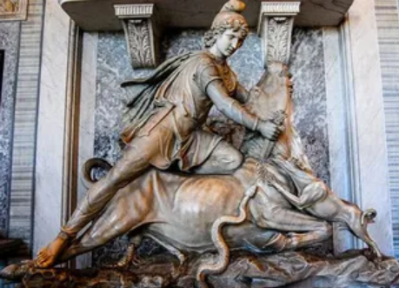
More Mithras Issues
No evidence that Mithras had 12 disciples
Or that he was called the “Good Shepherd”
That he was identified with “the Lion”
That he rose again after 3 days
Plausible vs. Possible
Where is the evidence?
Notes:
Plausible vs. Possible: This Mithras myth focuses on what might have been possible instead of what is most reasonable
“Aliens” are another speculation that folks point to in order to deny evidence they are not comfortable with. A distraction.
How someone sounds or how well their presentation of their viewpoint is not considered evidence on its own just as the remarks of attorneys cannot be considered evidence in court.
Only the witnesses’ answers are evidence.

Slide 8
Prepare for the attack
Be able to identify tactics that distract from the evidence
Be able to identify when someone is being unreasonable
Be a good Christian case maker
Master the facts/evidences
Don’t fall for speculation that lacks evidence
Emotional appeals are not rational ones
Prepare for an attack on truth
Notes:
-Prepare - What is truth? the best explanation of reality.
To not believe what is true is to be out of touch with reality.

Slide 9
for more information visit:
www.ColdCaseChristianity.com

